Slide 1
Myntra Wishlist The Demand Already Exists. The Conversion Doesn't.
Mobile MAU
90M+
(Mar 2026, all-time high)
Operating Revenue
Revenue
₹6,043 Cr
(FY25, +18% YoY)
Purchase Frequency
Gen Z 8–10x/yr
vs.
Millennial 4–5x/yr
Repeat Purchase Rate 51.79% of fashion buyers ordered >1x (Q1 2026)
GROWTH TEAM'S KPI: % of users who purchase ≥1 item from their wishlist within 30 days of adding it
COMPETITIVE LANDSCAPE — INDIAN FASHION E-COMMERCE (2025-26)
WHY THIS METRIC MATTER
👤 FOR USERS The pieces they already said yes to actually reach their wardrobe — not just sit in a saved list.
🏷️ FOR BRANDS Items shoppers already chose finally convert — real demand closed, not re-earned from scratch with a new discount.
📈 FOR MYNTRA Revenue from interest it already has — no new ad spend, no new discount, just closing what's already open.
Player | Est. Market Share (Fashion) | Positioning
MYNTRA | 32–35% | Trend-first, Gen Z-led, content-to-commerce
FLIPKART FASHION | 25–30% | Mid-market ethnic & western, cross-funded by electronics
AMAZON | 20–25% | Global brands/luxury beauty, Prime cross-sell
MEESHO | ~18% | Unbranded "Bharat" fashion, budget segment
AJIO / NYKAA FASHION | Not covered in this estimate | Private-label/omnichannel (AJIO) · Beauty-led p
Sources: Sensor Tower, State of eCommerce 2026 (Mar 2026) · Myntra RoC filings, FY25 · Myntra CEO Nandita Sinha, TechSparks, Nov 2025 · Vumonic Datalabs, Jun 2026, DFU Publications, "Inside the Fashion Matrix," Jul 2026 (analyst estimate, denominator unspecified)

Slide 2
REVIEW EXTRACTED
AFTER DEDUPLICATE
CLEANED & ANALYSED
PLAY STORE
APP STORE
REDDIT
Youtube Comments
HOW THE ENGINE WORKS
HOW THE DISCOVERY ENGINE LOOKS?
WHAT IS DISCOVERY ENGINE SAYS?
The wishlist captures desire, not commitment. Saving an item can mean high intent, comparison, future use, price monitoring, or inspiration.
The friction shifts from discovery to confidence. Fit, fabric and real-world product uncertainty emerge as key questions before users commit.
The opportunity is to close the confidence gap at the wishlist → decision moment. Help users answer “Is this right for me?” before they postpone the purchase.
Data Sources
APP Store
Play Store
YouTube
Reddit
COLLECT
Collect from 4 public Sources
CLEAN
Raw data -> Cleaned data
AI TAGGING
LLM classifies the verbatism
AGGREGATE
DASHBOARD
Tagged clusters with verbatim evidence
ASK ASSISTANT
Grounded answer from reviews only

Slide 3
SEGMENT 1
HIGH WISHLIST USAGE+ LOW CONVERSION
"I want it, but I'm not confident enough.“
SEGMENT 2
HIGH WISHLIST USAGE+ HIGH CONVERSION
"What are they doing differently?“
SEGMENT 3
LOW/NON WISHLIST USERS
"Wishlist isn't central to their journey.“
Who are they?
Wishlist items regularly and repeatedly, don't delete them.
Rarely complete a purchase from what they save.
Sit inside the North Star's denominator (they have wishlist activity) but outside its numerator (they don't convert).
Current Behaviour
Adds items to wishlist, opens it repeatedly over days or weeks.
Compares it against similar options, sometimes checks reviews.
Leaves the item wishlisted — no purchase, no deletion
Who are they?
Rarely use the wishlist at all, regardless of whether they convert.
Buy directly or browse without saving.
Current Behaviour
Buys directly, or browses without saving
Uses wishlist rarely, if at all
Doesn't treat it as part of their decision process
Who are They?
Also wishlist heavily — same volume of intent as Segment 1.
But convert at a meaningfully higher rate.
Studying them tells us what already resolves the confidence gap, without us having to guess.
Current Behaviour
Wishlists at the same rate as Segment 1.
Returns to the item once, sometimes twice then decides.
Why Not Selected: Already converts well — not the problem, the benchmark. Their behavior shows the fix, not the gap. Used for comparison, not investigation.
Why Not Selected: Blocker sits before the wishlist, not after. No wishlist means nothing to convert — outside the North Star entirely.
Biggest Pain Point: ⚠️ The last confidence check never happens. So the decision just stays open.
WHY THIS SEGMENT
Already active, not converting. Inside the metric's denominator, outside its numerator — every case we resolve moves it directly..
Largest signal in the data. Fit, fabric, and photo-reality doubt — the engine's top 3 themes — sit exactly here.
Trust already exists. They save and return often enough to prove the brand isn't the block — the decision is.
Highest business impact. Converts demand already generated. No new spend, no discount — just closing what's already open.

Slide 4
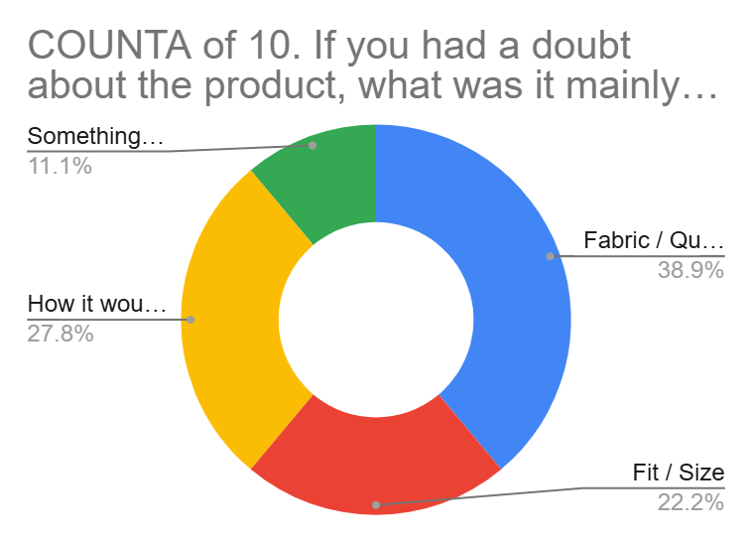
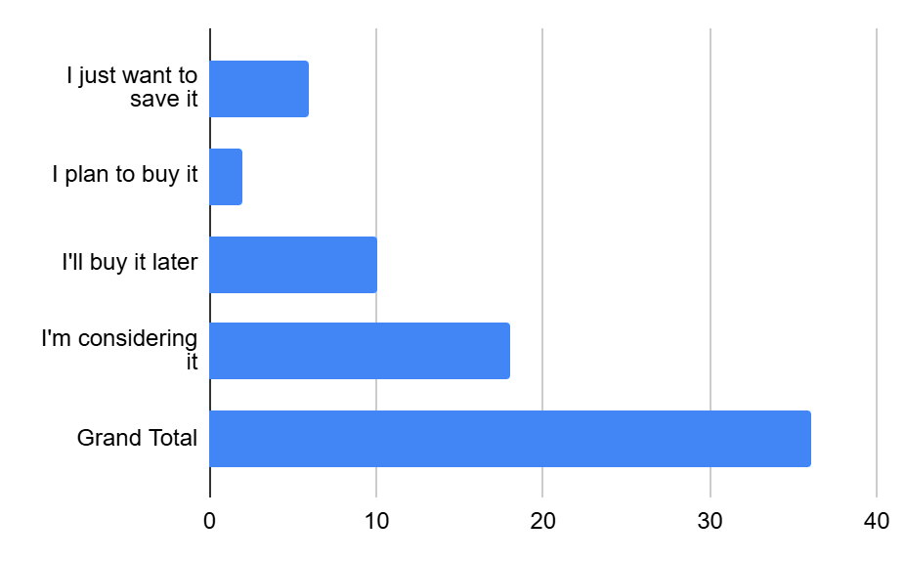
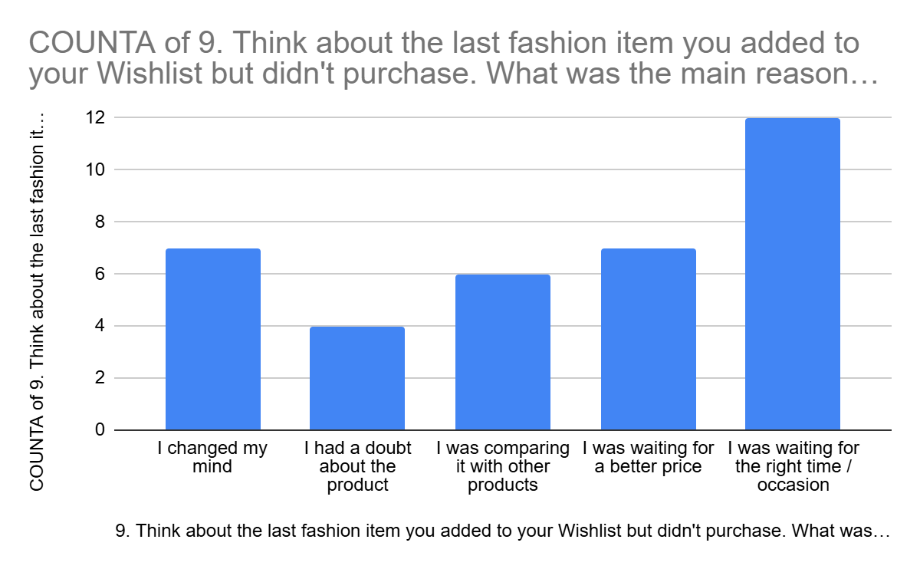
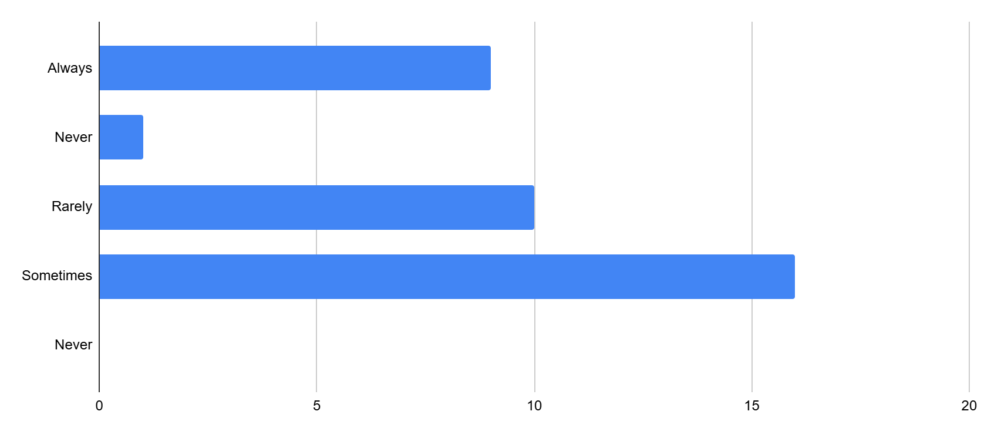
HYPOTHESIS | EXPLANATION | ENGINE SIGNAL
H1 — The doubt has a name, not a shrug | Users wishlist items they already like, so the block isn't desire — it's a specific, nameable doubt: how the fabric feels, whether the size will hold, or if it matches the photo. | 68% Fit & Sizing + 13% Fabric Quality + 10% Photo vs Reality are the strongest friction signals.
H2 — Confidence gets built off the app, not on it | When doubt hits, users don't always stay on Myntra to resolve it — they may seek reassurance through Reddit, YouTube, creators, or other people's opinions before completing the purchase. | 82% of classified intent signals are high intent but blocked by uncertainty. The engine identifies the confidence gap, but does not establish where users resolve it — this is what primary research must test.
H3 — The wishlist is a parking lot for decisions | Saving an item does not always mean the user intends to buy it immediately. Some users save for a future occasion, wait for the right moment, or keep items for comparison. | 10% wait for an occasion, 7% monitor price drops, and 1% save for inspiration/bookmarking.

Slide 5
WHAT IS THE TRUE PROBLEM?
WHO IS FACING THE PROBLEM?
HOW DO WE KNOW IT’S REAL?
WHAT IS SOLVING THIS PROBLEM?
WHY SHOULD WE SOLVE THIS PROBLEM?
FOR USERS

Slide 6
Prioritize the Solution

